Slide 1
Recommender Engine
A Springboard Capstone Project | 2025

Slide 2

The Problem
In the current digital landscape, users encounter an overwhelming abundance of information and options across various platforms, which is particularly notable in e-commerce websites (products), streaming services (movies and music), social media (content), and news platforms.
Consequently, users frequently have trouble locating or navigating through the vast selection of items or content that resonate with their interests, which can lead to a suboptimal user experience
Notes:
In the current digital landscape, users encounter an overwhelming abundance of information and options across various platforms, which is particularly notable in e-commerce websites (products), streaming services (movies and music), social media (content), and news platforms.
Consequently, users frequently experience difficulty in locating or navigating through the vast selection of items or content that resonate with their interests, which can lead to a suboptimal user experience

Slide 3
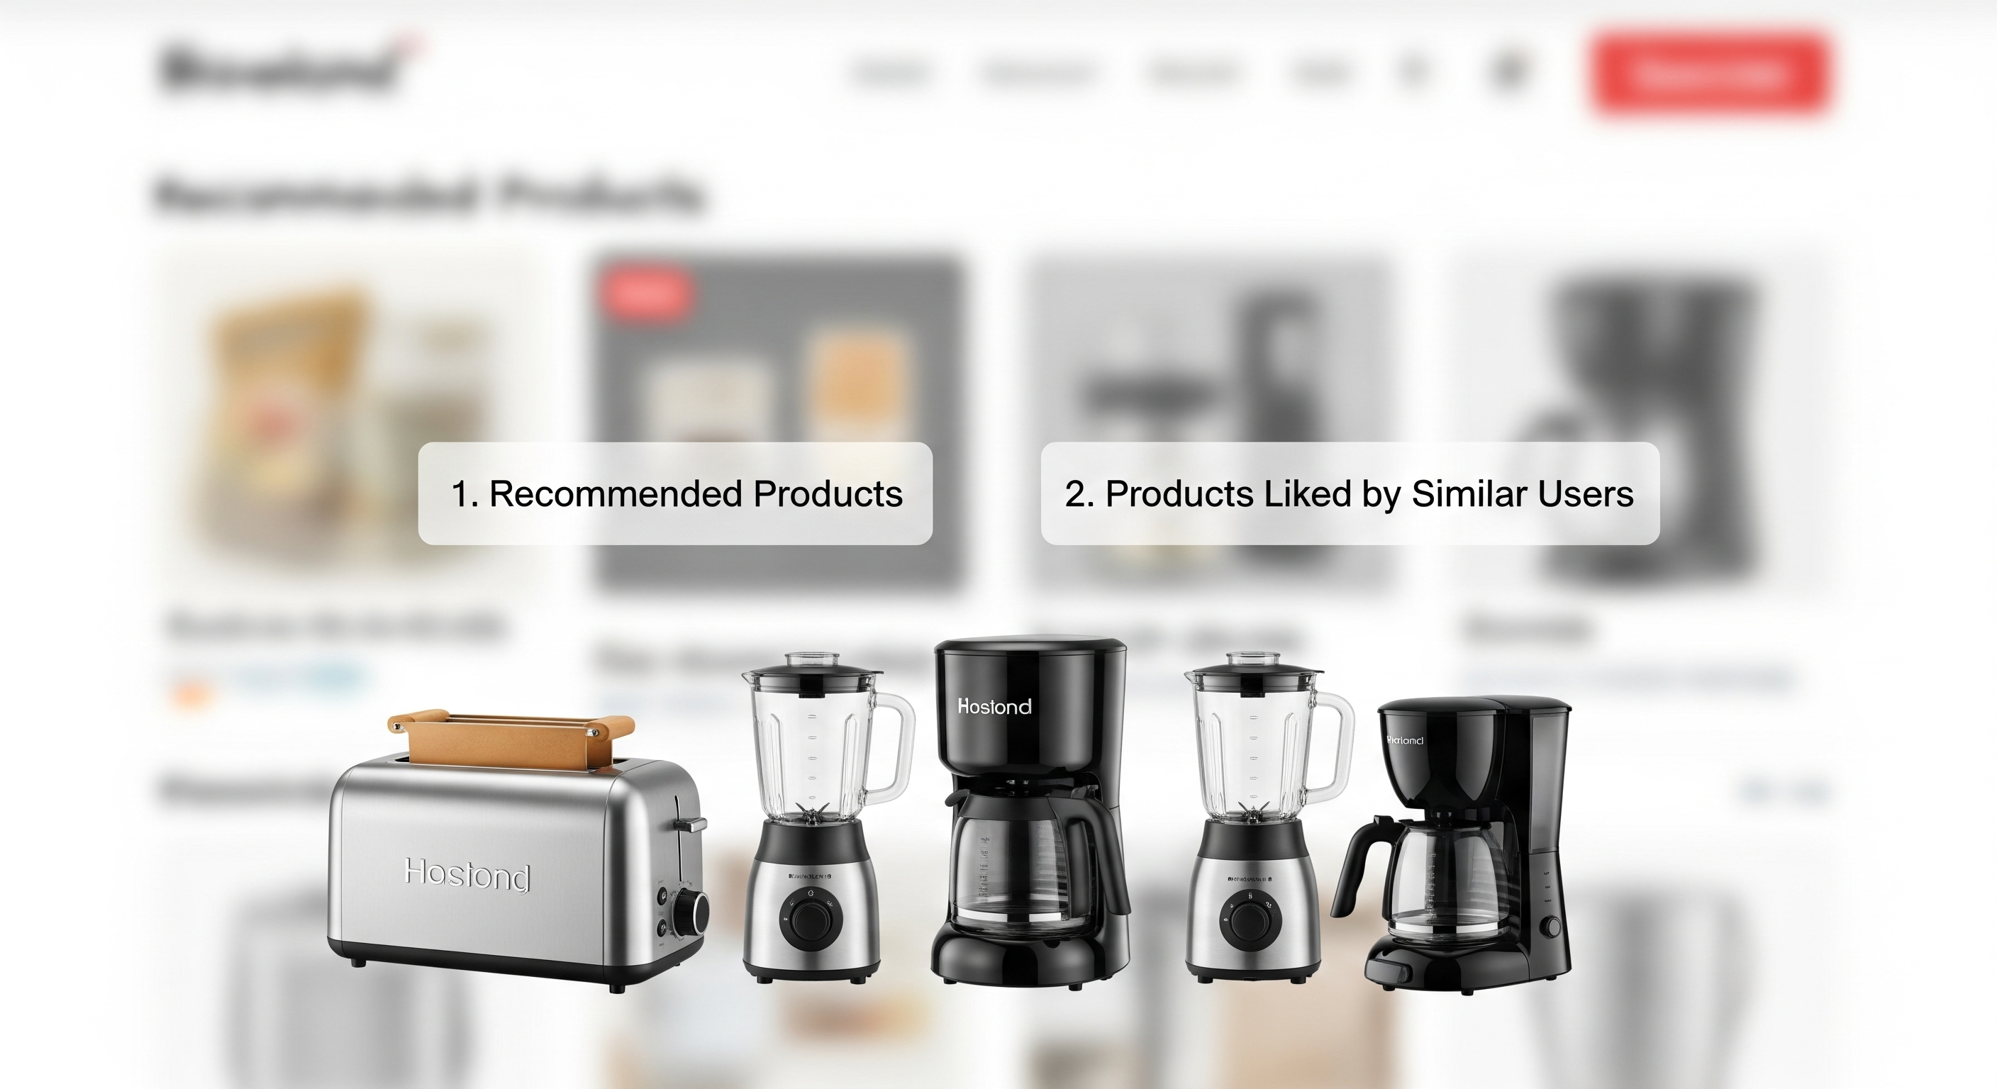
The Challenge
Effective filtration of information overload
Personalized recommendations
that are relevant, engaging, and aligned with user preferences
Notes:
In the current digital landscape, users encounter an overwhelming abundance of information and options across various platforms, which is particularly notable in e-commerce websites (products), streaming services (movies and music), social media (content), and news platforms.
Consequently, users frequently experience difficulty in locating or navigating through the vast selection of items or content that resonate with their interests, which can lead to a suboptimal user experience

Slide 4

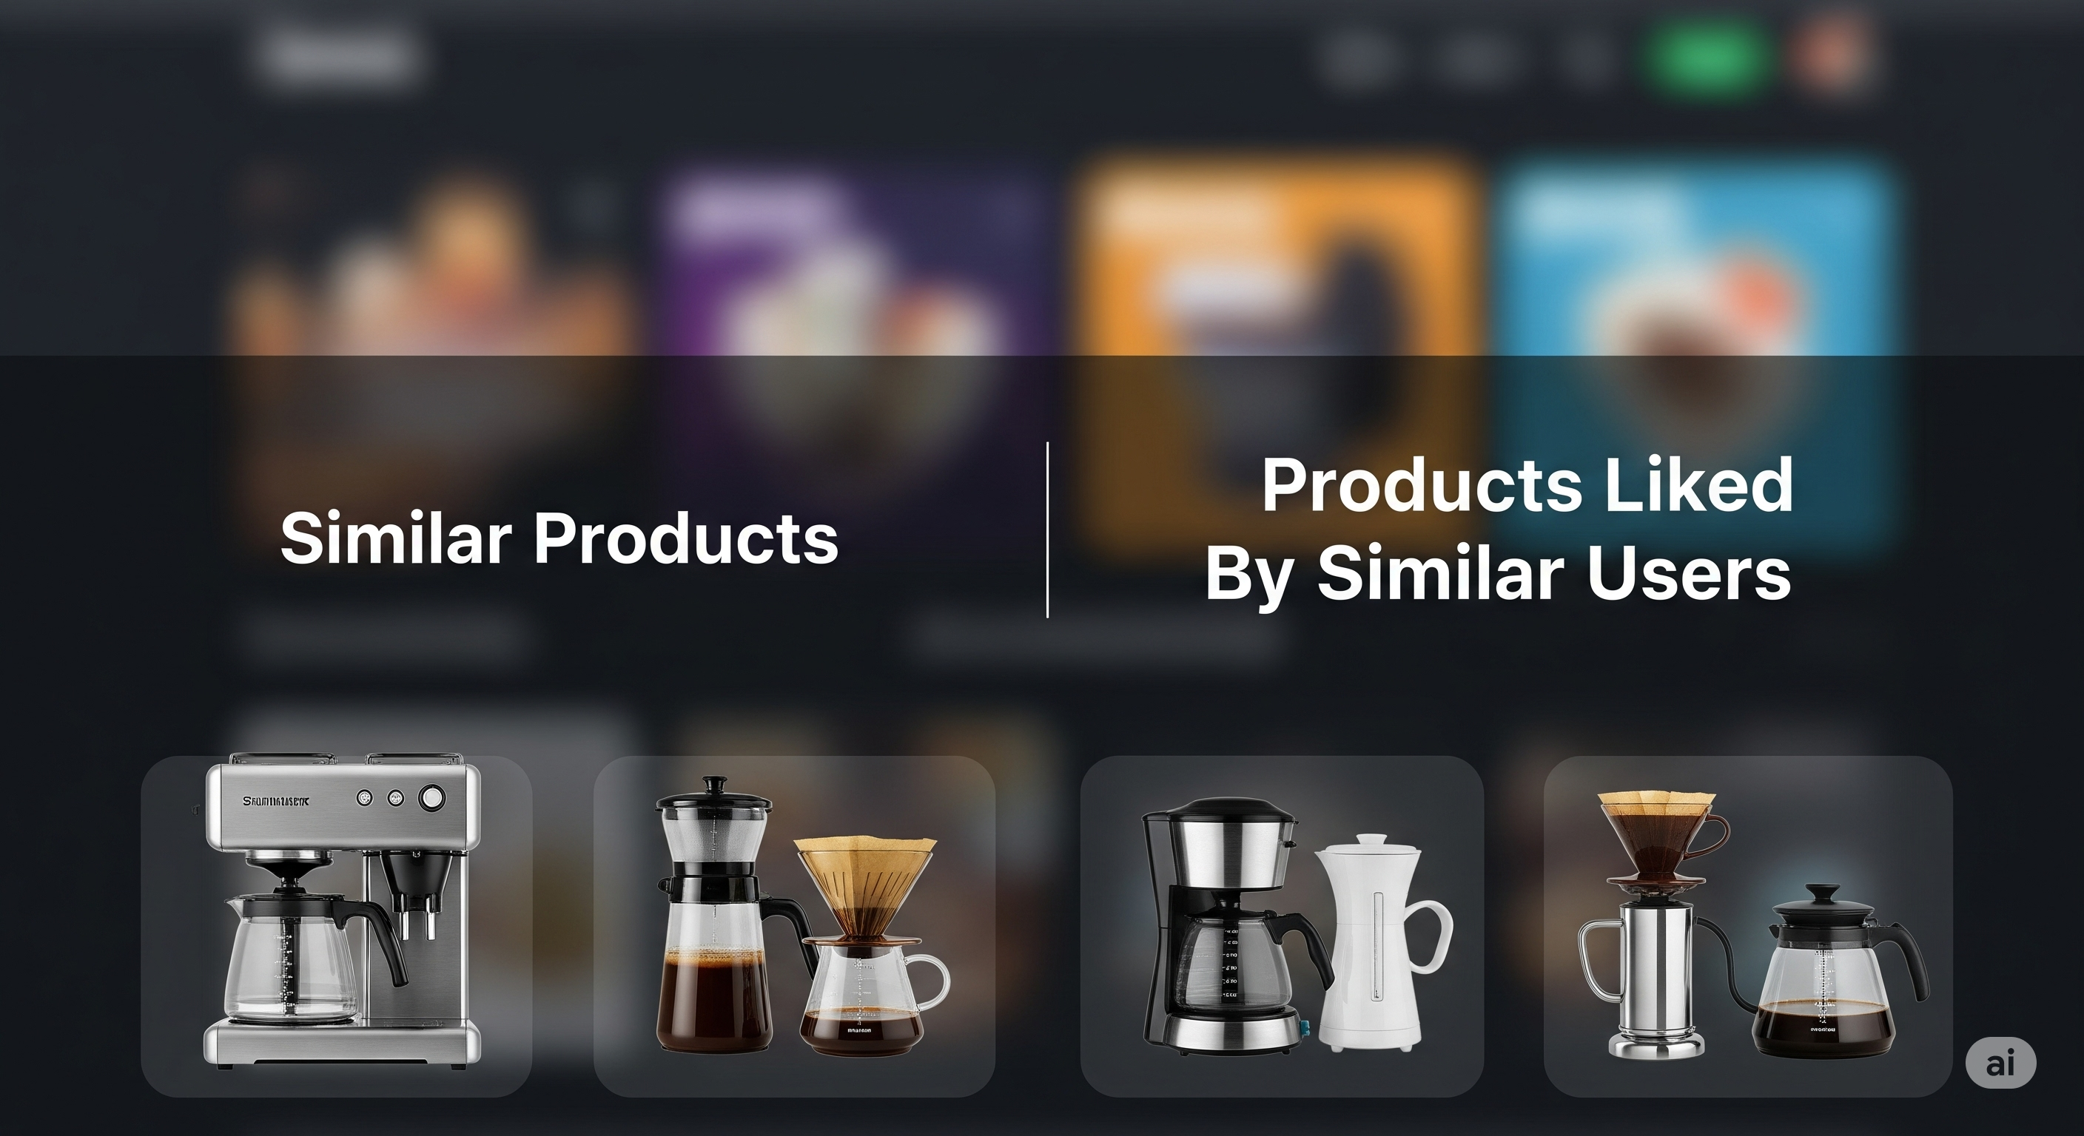
Objective
Alleviate the cold-start problem for both new users and new items
Enhance the accuracy and relevance of recommendations:
Collaborative filtering
Content-based filtering
Hybrid approaches

Slide 5

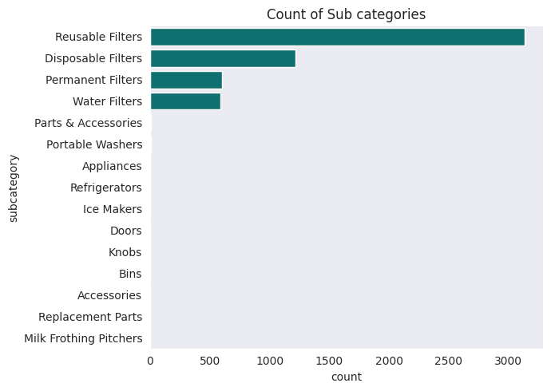
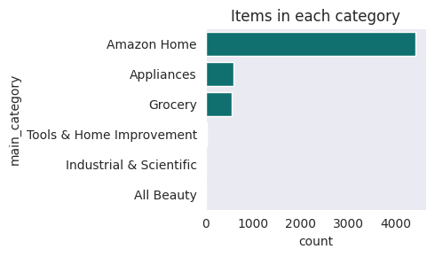
Exploratory Data Analysis
Summary Statistics
Unique products: 27–30
Unique users: ~5363
Total ratings: ~5567
Average ratings per product: ~206.93
Average ratings per user: ~1.04

Slide 6
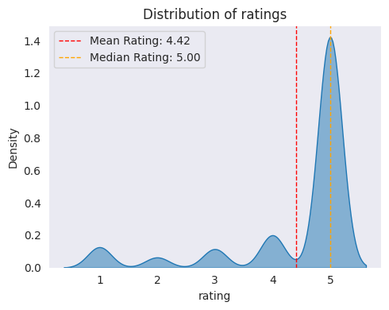
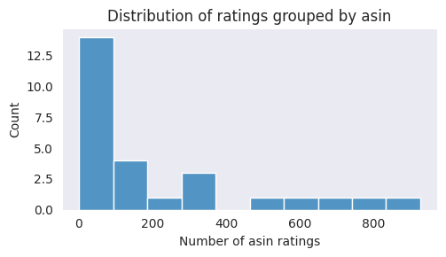
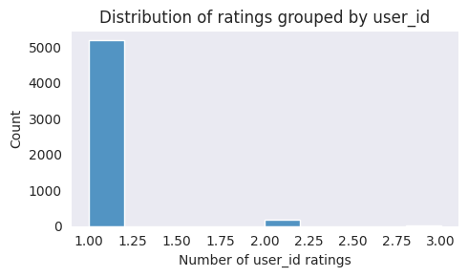
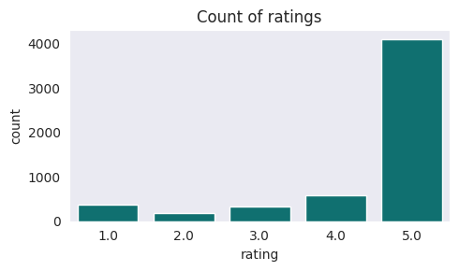
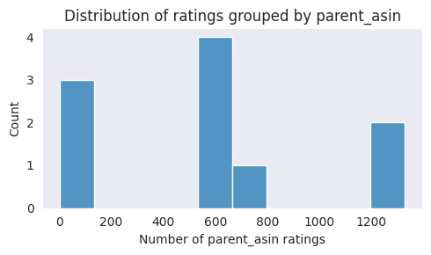
Exploratory Data Analysis

Slide 7
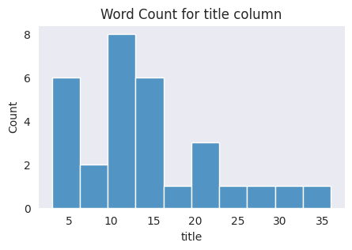
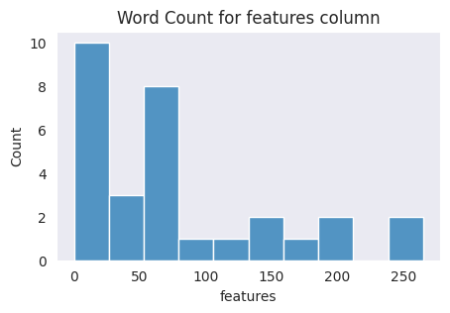
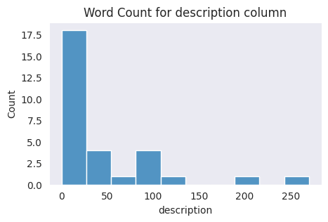
Exploratory Data Analysis
A right-skewed distribution indicates the presence of outliers
Evident in some products, which have very lengthy titles, descriptions, etc.
Setting a threshold on word lengths may have a significant/low impact on computational power, as this will reduce dimensionality
Caveats: Word reduction / omission may reduce accuracy on similarity searches

Slide 8

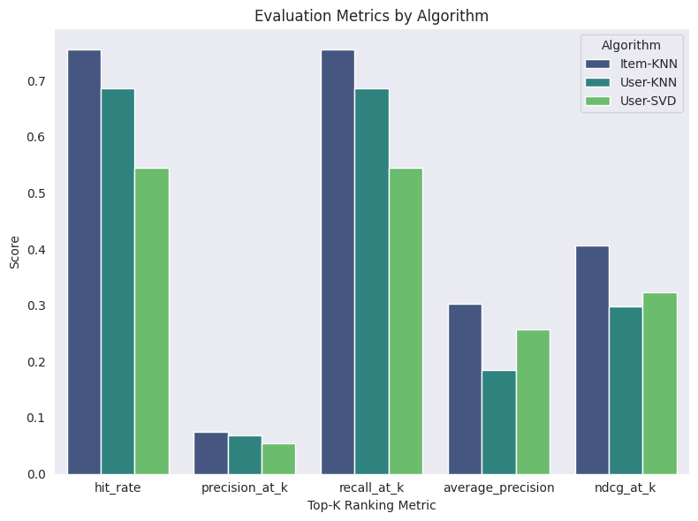
Modeling Performance
Item-based Collaborative Filtering performed best in all metrics for all Top-K rank-based metrics

Slide 9



Thank you
Edu Mosada Jr.
edu.mosada.jr@gmail.com
https://github.com/ds-edu
https://linkedin.com/in/edumosada

